Slide 1

Newborn Name Analysis
Hlib Melnychenko

Slide 2

Project Goals 📍
Help parents make data-driven decisions when selecting a name.
Support the startup's goal of selling customized products.

Slide 3

Two wins with one move 2️⃣
We have to directly deal with:
Parents (company’s clients).
Business decision makers from startup company.
Solution: Interactive and user – friendly SSBI tool
For example: Tableau, PowerBI

Slide 4



Drawbacks of this approach 🚫
Though this solution is not bad, it has number of disadvantages:
Licences, hosting and usage of the BI platform are expensive.
I must proclaim my knowledge in SQL and Python as a Data Engineer

Slide 5

Alternative solution – Streamlit ✅
Open – source Python library
Works perfectly with various visualisations
Possibility to upload an interactive web page
Hosting of 1 app is free
Extremely multifunctional

Slide 6

Technical Part

Slide 7
Data Understanding
NationalNames: Count by Name, Year and Gender
StateNames: Count by Name, State, Year and Gender
SQLite DB
MD5 hashes – identical
Data in NationalNames and StateNames is consistent

Slide 8
Tasks to Fulfil Project Goals
Prepare all the data in SQL (DB Browser for SQLite)
Convert to CSV (or make direct DB query)
Read and transform data in Python (Pandas)
Make an interactive app with visualizations in Streamlit
Make a concept of visualizations satisfying both company and clients
Define main insights to show as an output

Slide 9
Main insights
Show change of names period-over-period nationally and by state
Popularity of names across states on US map
Top 50 names nationally and by state for a given year
Top Unisex names nationally and by state

Slide 10
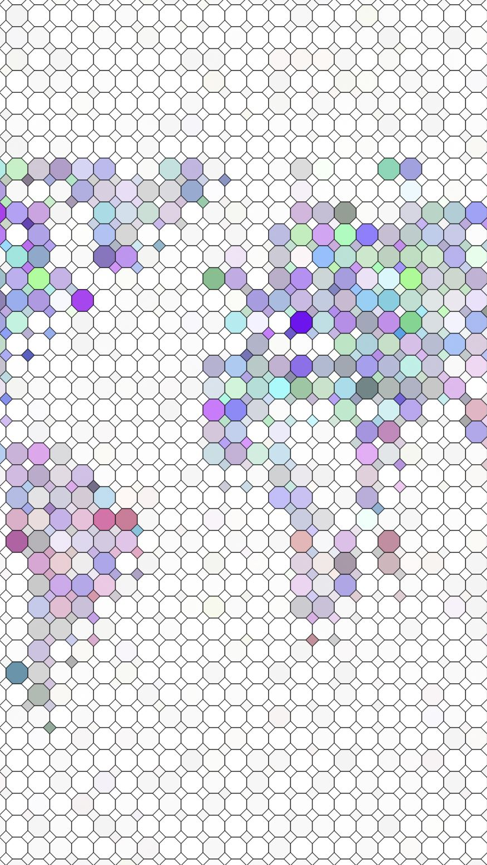
Visualization concept
Popularity of StateNames (Line Graph, X – year, Y – count (sum), Filter – name, gender, year, state (all states = nationally)).
Map of StateNames (Choropleth map, axis – US states, color - count of names, Filter – name, year, gender).
Top50 NationalNames (both Genders) by Count of Names (Filter - year) and StateNames (both Genders) by Count of Names (Filter – year, state).
Top Unisex NatinonalNames by Unisex_score and Count of Names (Filter - year) and StateNames by Unisex_score and Count of Names (Filter – year, state).

Slide 11
SQL Data Preparation
Database Manager – DB Browser for SQLite (others – overkill).
StateNames and NationalNames year >=1960 (only prototype, speedup the. process). ➔ CSV files (NationalNames1960.csv and StateNames1960.csv).
Will be used for 3 first visualizations.
Create 2 views (Top30_Unisex_Names_by_State and Top50_Unisex_Names_National)
Will be used for 4th visualization.

Slide 12

Interactive Streamlit App 🚀
https://strvcasestudy-hlib.streamlit.app/

